Slide 1

Superstore Sales Analysis
Presented by: Rawan Haitham, Engy Talaat, Yara Osama, Toqa Kashef, Raneem Zaki
Supervised by: Eng. Ahmed Samir

Slide 2
Table of contents
01
02
03
04
05
Data Cleaning
Analysis Question
Forecasting
Visualization
Recommendations

Slide 3
01
Data Cleaning

Slide 4
Data Cleaning Process
Removed unnecessary columns (“Row ID” “Customer Names” “Postal Codes”)
Check for duplicate rows.
Checked for Null Values
Replaced Null Values
Changed Data Types
Checked For Outliers and removed them.
df_cleaned = df.drop(columns=['Row ID', 'Customer Name' , 'Postal Code'])
df.duplicated().sum()
df.isnull().sum()

Slide 5
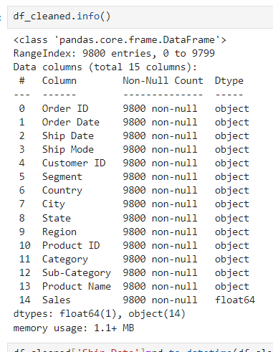
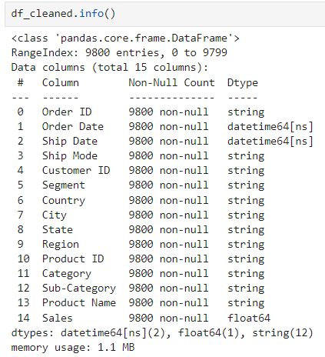
Data Cleaning Process
Data before changing data type:
Data after changing data type:

Slide 6
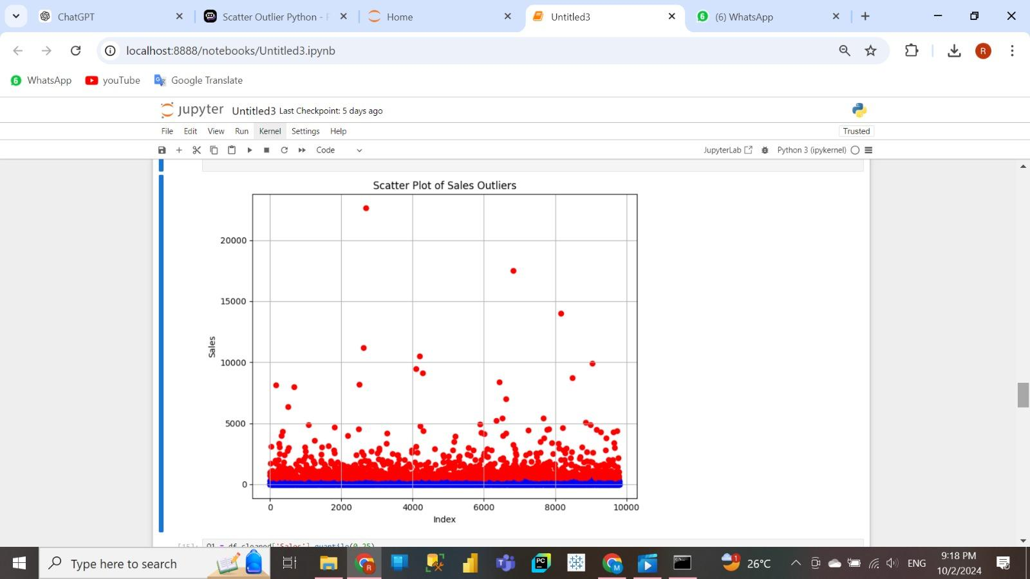
Data Cleaning Process
Checked For Outliers and removed them.
Q1 = df['Sales'].quantile(0.25)
Q3 = df['Sales'].quantile(0.75)
IQR = Q3 - Q1
lower_bound = Q1 - 1.5 * IQR
upper_bound = Q3 + 1.5 * IQR
outliers = df[(df['Sales'] < lower_bound) | (df['Sales'] > upper_bound)]
non_outliers = df[(df['Sales'] >= lower_bound) & (df['Sales'] <= upper_bound)]

Slide 7
Data Cleaning Process
Results Before & After Removing the Outliers
original_rows = df_cleaned.shape[0]
non_outliers = non_outliers.shape[0]
original_rows, non_outliers
The result showed that there were about 1,145 rows that were not in the range.
Before
9800
After
8655

Slide 8
02
Analysis Questions

Slide 9
Analysis Questions
Sales Performance Analysis
Customer Behavior Analysis
Regional Analysis
Product Performance Analysis
Logistics and Operational Analysis

Slide 10
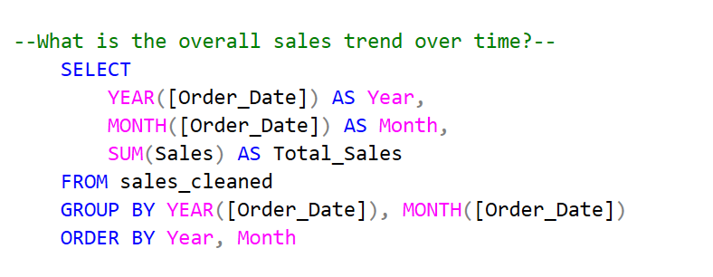
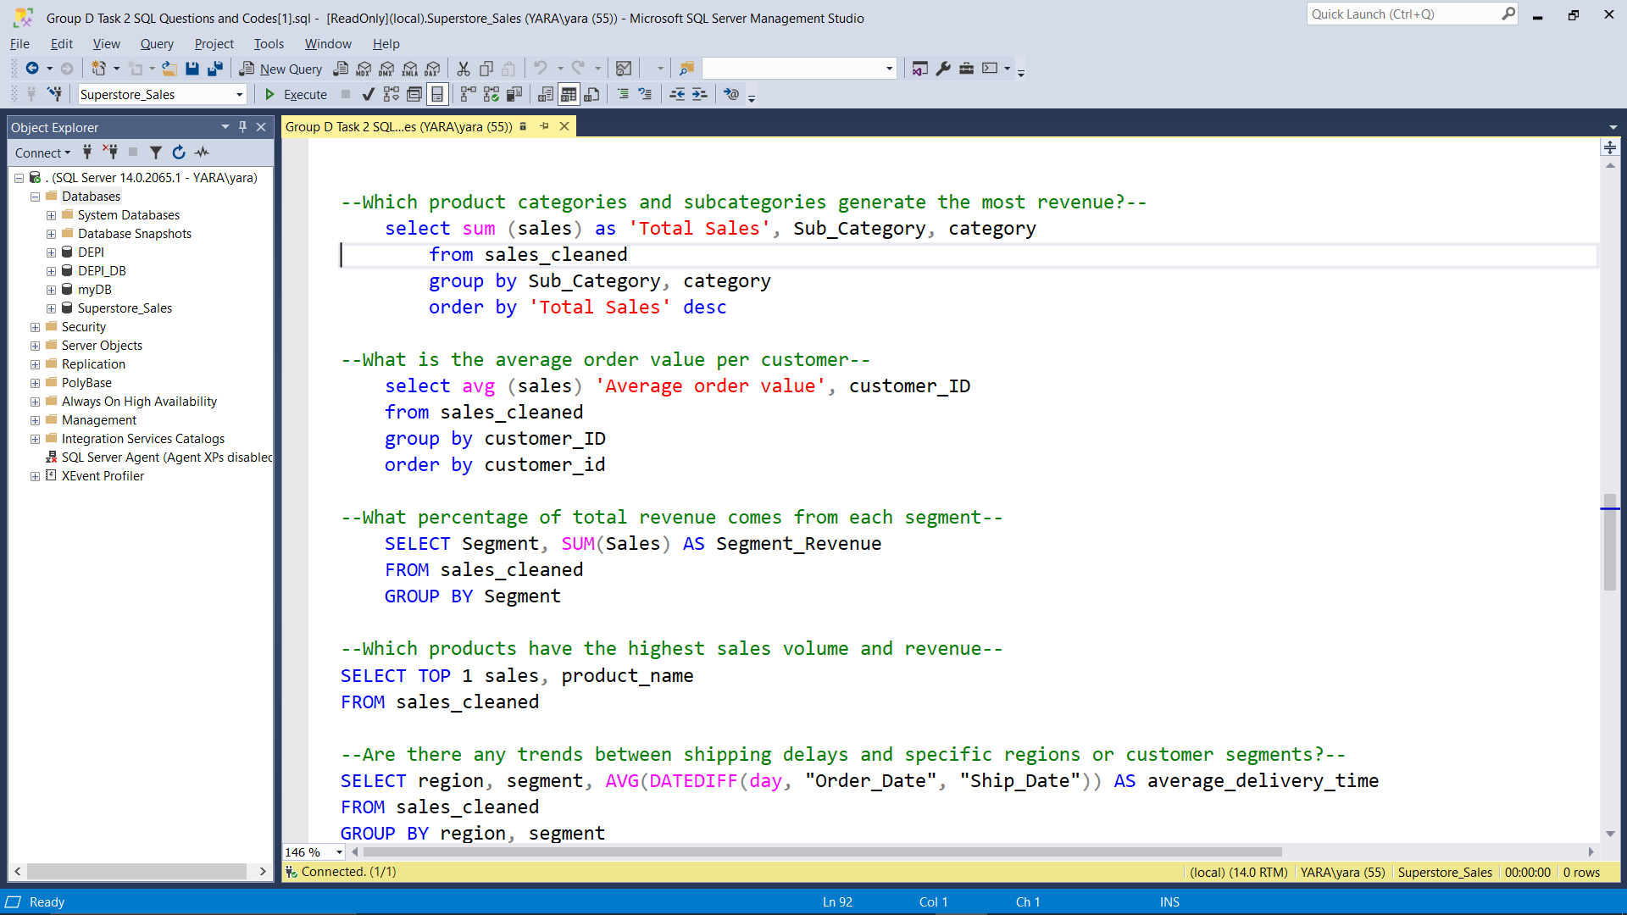
Sales Performance Analysis Questions
What is the overall sales trend over time?
What is the average order value per customer?

Slide 11
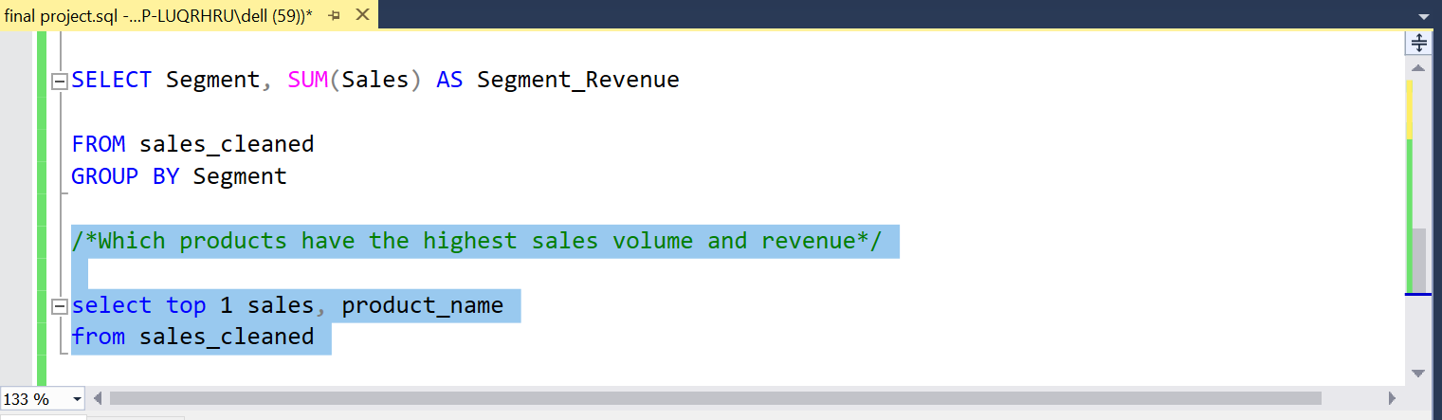
Sales Performance Analysis Questions
Which products have the highest sales volume and revenue?

Slide 12
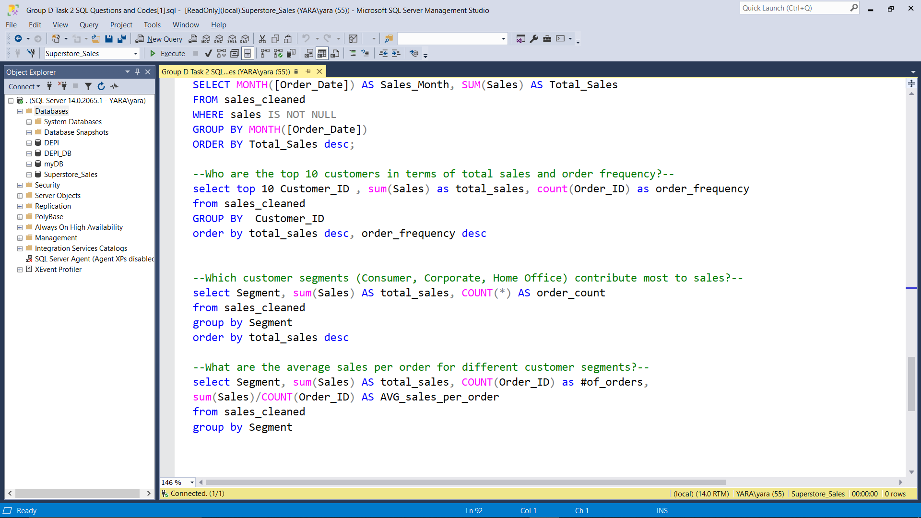
Customer Behaviour Analysis Questions
Which customer segments (Consumer, Corporate, Home Office) contribute most to sales?

Slide 13
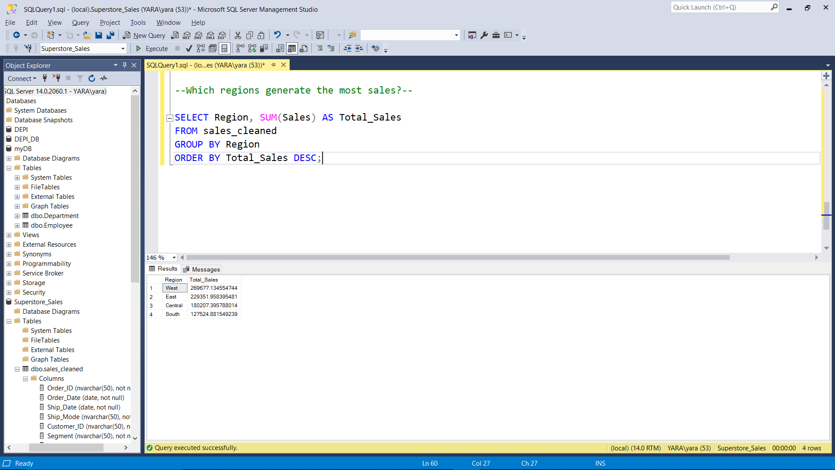
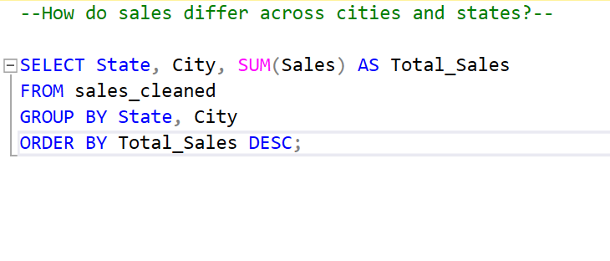
Regional Analysis Questions
Which regions generate the most sales?
How do sales differ across Cities and States?

Slide 14
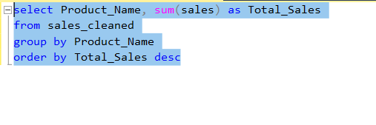
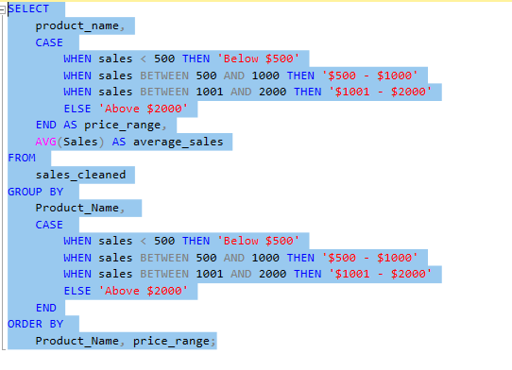
Product Performance Analysis Questions
Which products have the highest return rates or lowest sales performance?
How does product price impact sales?

Slide 15
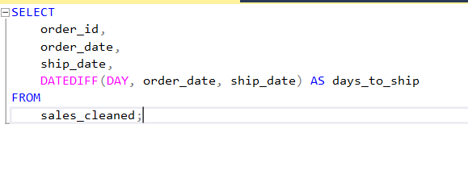
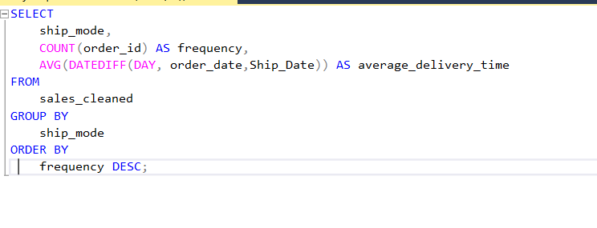
Logistics and Operational Analysis Questions
What is the average delivery time from order to shipping for each shipping mode?
Which shipping methods are the most used by customers, and how do they impact delivery times?

Slide 16
03
Forecasting Questions

Slide 17
Forecasting Questions
What will the sales be in the next month/quarter/year for each product category?
Which regions are expected to see the most growth in sales?
How will the demand for different product categories evolve over time?
What are the expected peak sales periods in the upcoming months?
What will be the expected revenue for key customer segments (e.g., Consumer, Corporate, Home Office)?

Slide 18
Forecasting Codes
Imported Scikit-learn to use the train-test split and the linear regression to predict the future sales for each question.
Plotted the graphs that predicted how much products the store will sell in 2019.
Plotted the peak sales periods for each year for every category.
Predicted the revenue that’ll be generated by each consumer segment.

Slide 19
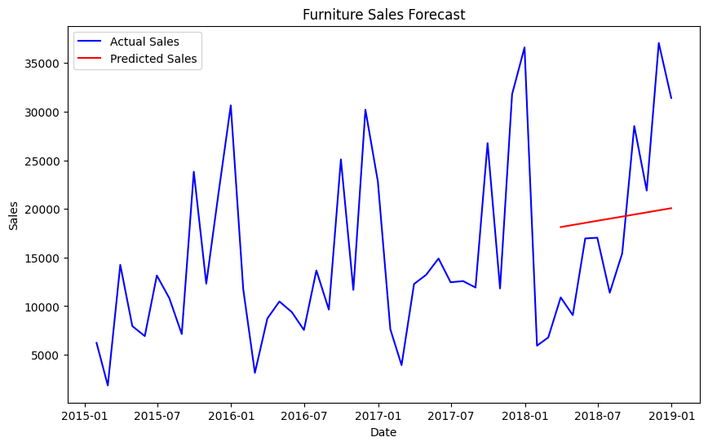
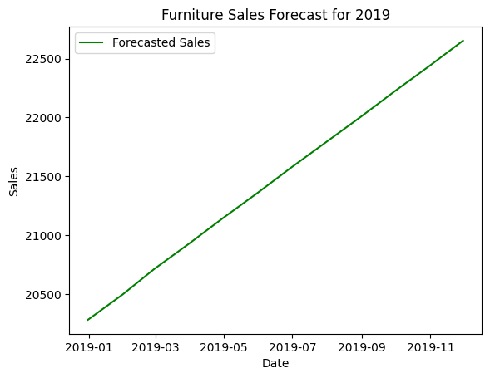
Forecasting graphs

Slide 20
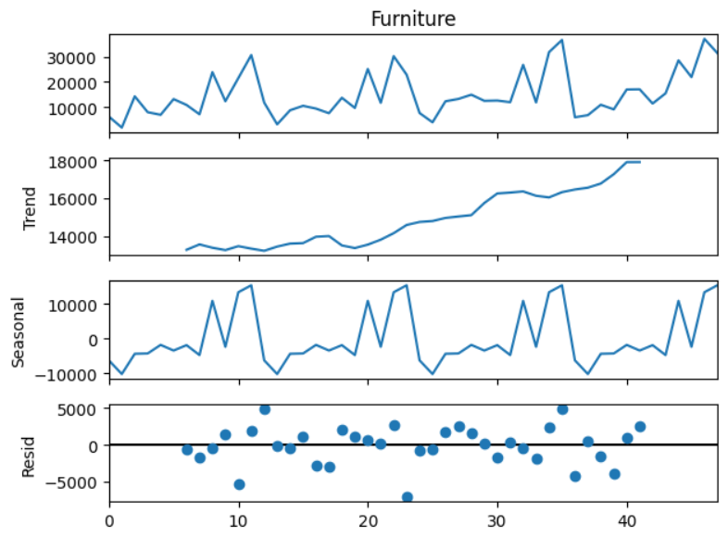
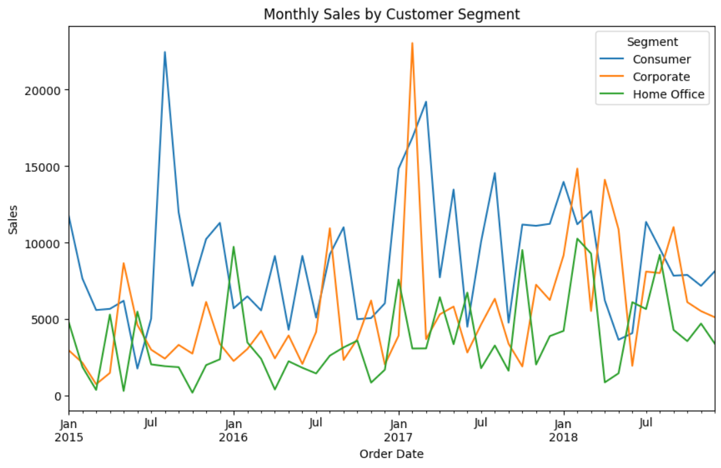
Forecasting graphs

Slide 21
04
Visualization

Slide 22
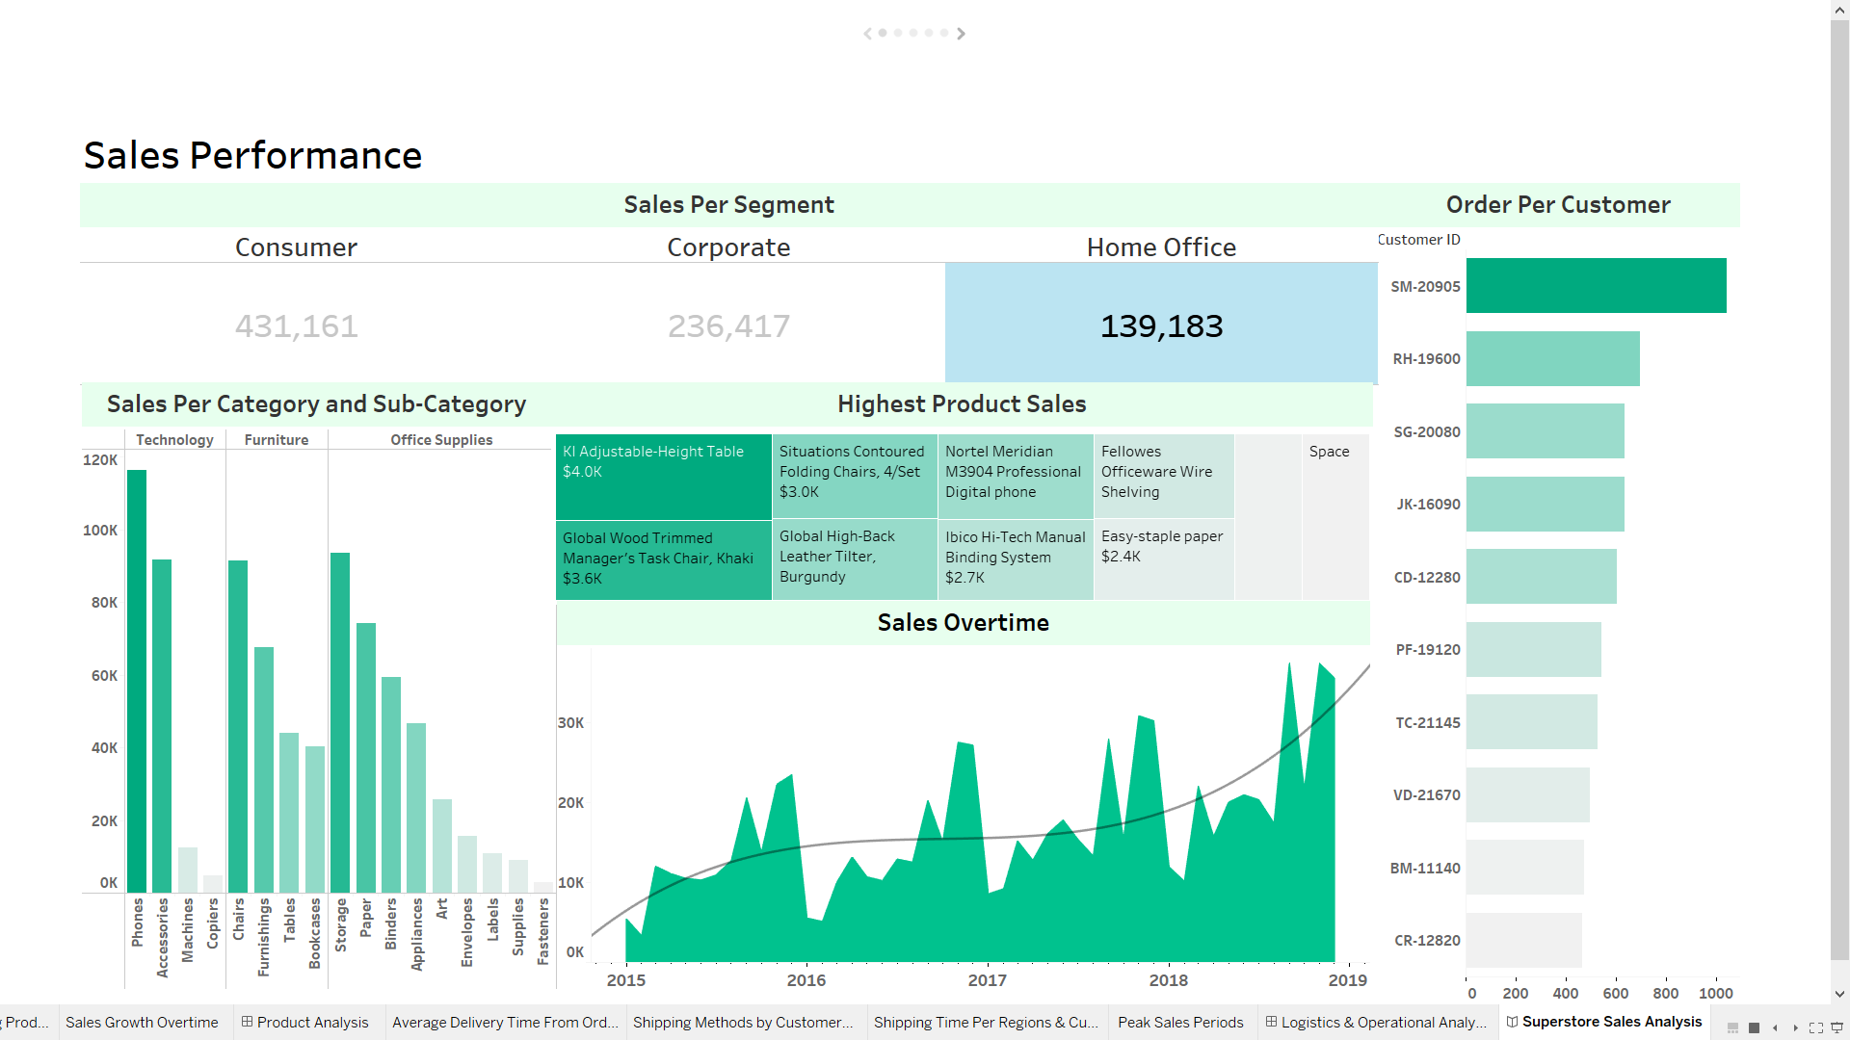
Sales Performance Storyboard

Slide 23
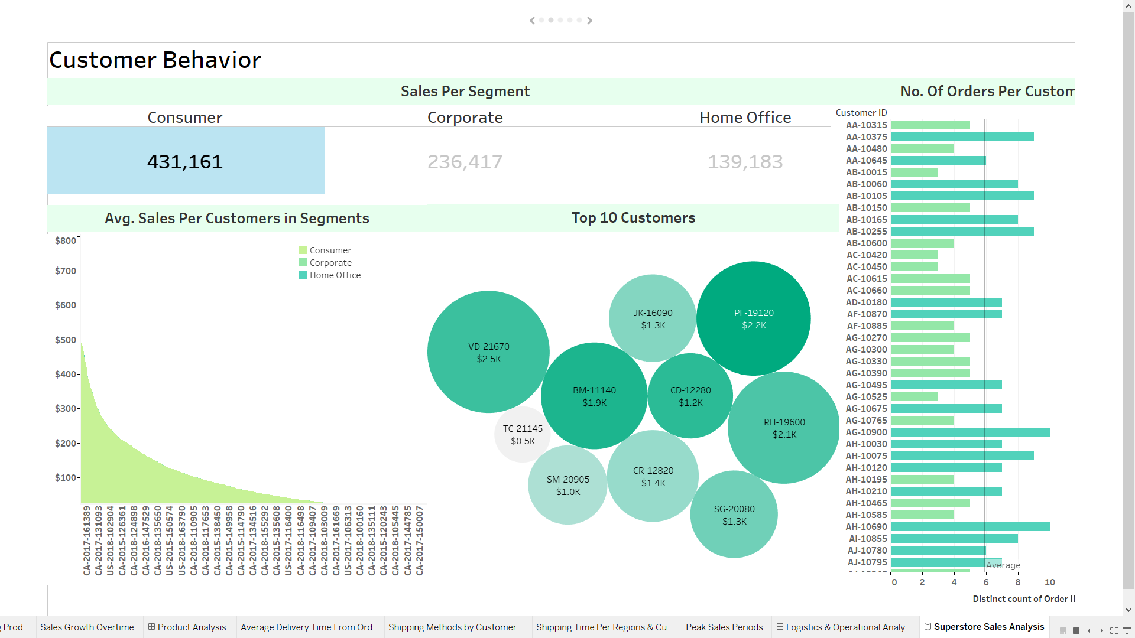
Customer Behaviour Storyboard

Slide 24
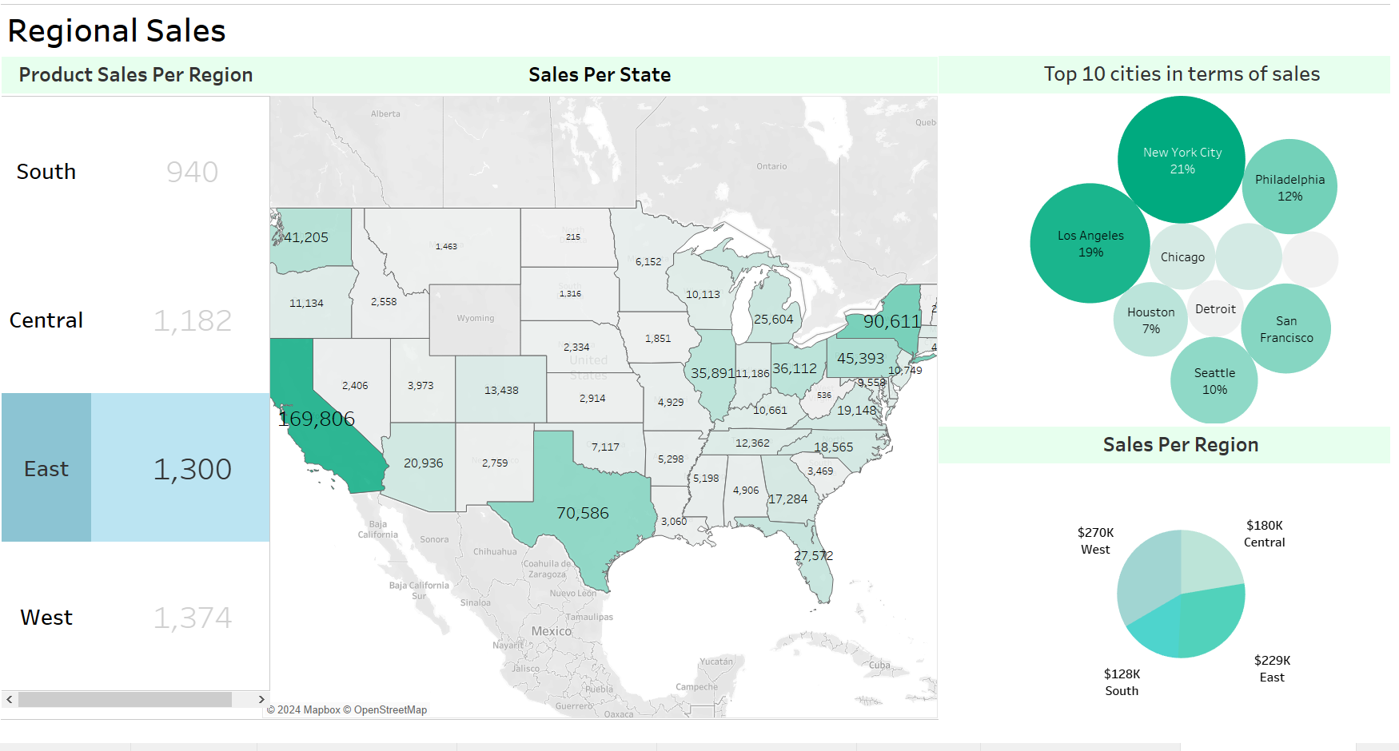
Regional Analysis Storyboard

Slide 25
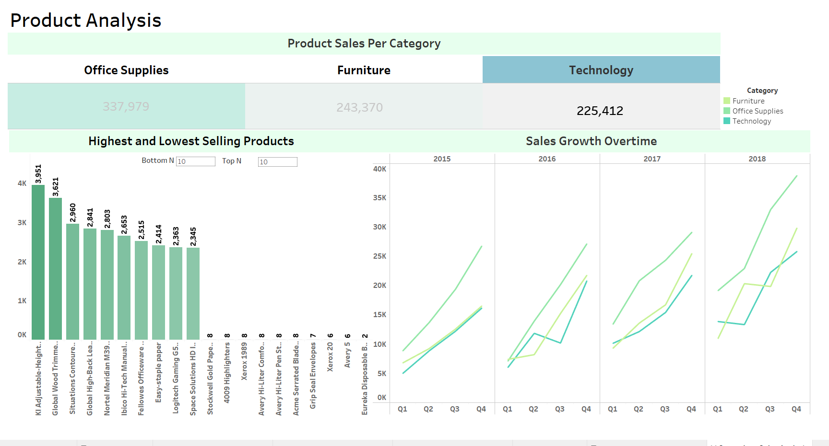
Product Performance Storyboard

Slide 26
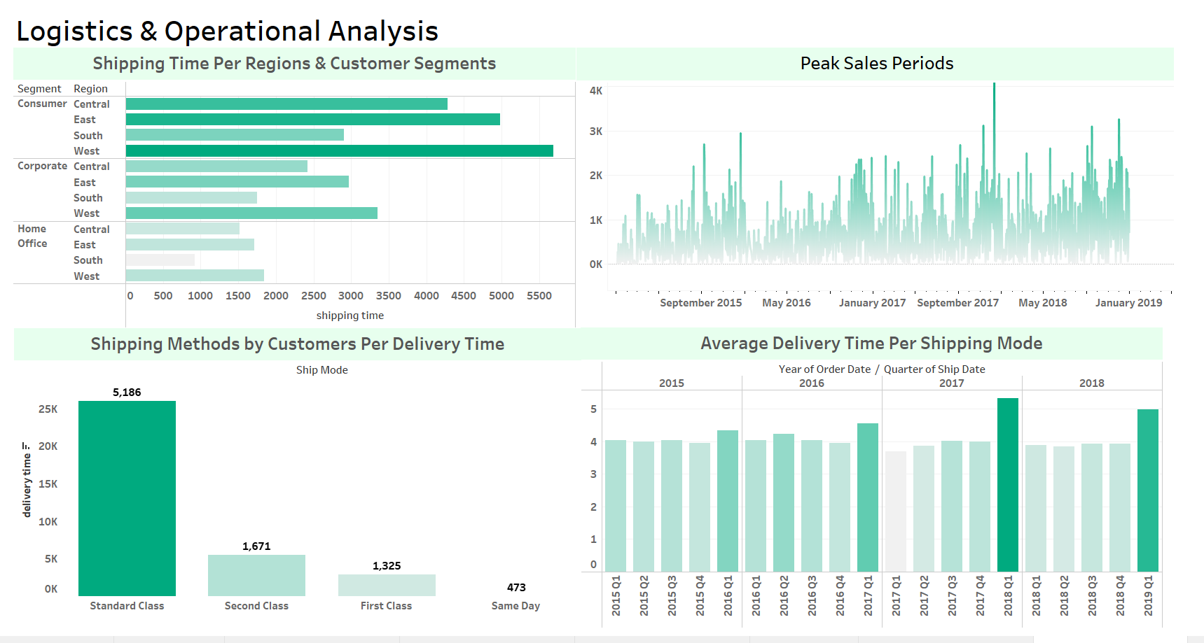
Logistics and Operational Storyboard

Slide 27
05
Recommendations

Slide 28
Recommendations
Focus on increasing the inventory in Sep, Nov, Dec 0f the year and prepare for the lower sales on the months of January and February.
Focus on making offers to the top 10 customers as they spend the most money on the store.
Increase the marketing for the home office and corporate segments.

Slide 29
Recommendations
Focus on improving the shipping to the West and East Regions as they have the most sales and focus the most on the state of California and New York.
Remove the lowest selling products as they’re non-profitable and focus more on the highest selling products.
Focus on the standard class as it’s used by the vast majority of the customers and focus on improving the shipping to the consumers segment.

Slide 30
Any Questions?
Thank You!

